Slide 1
APRS/PICO

Slide 2
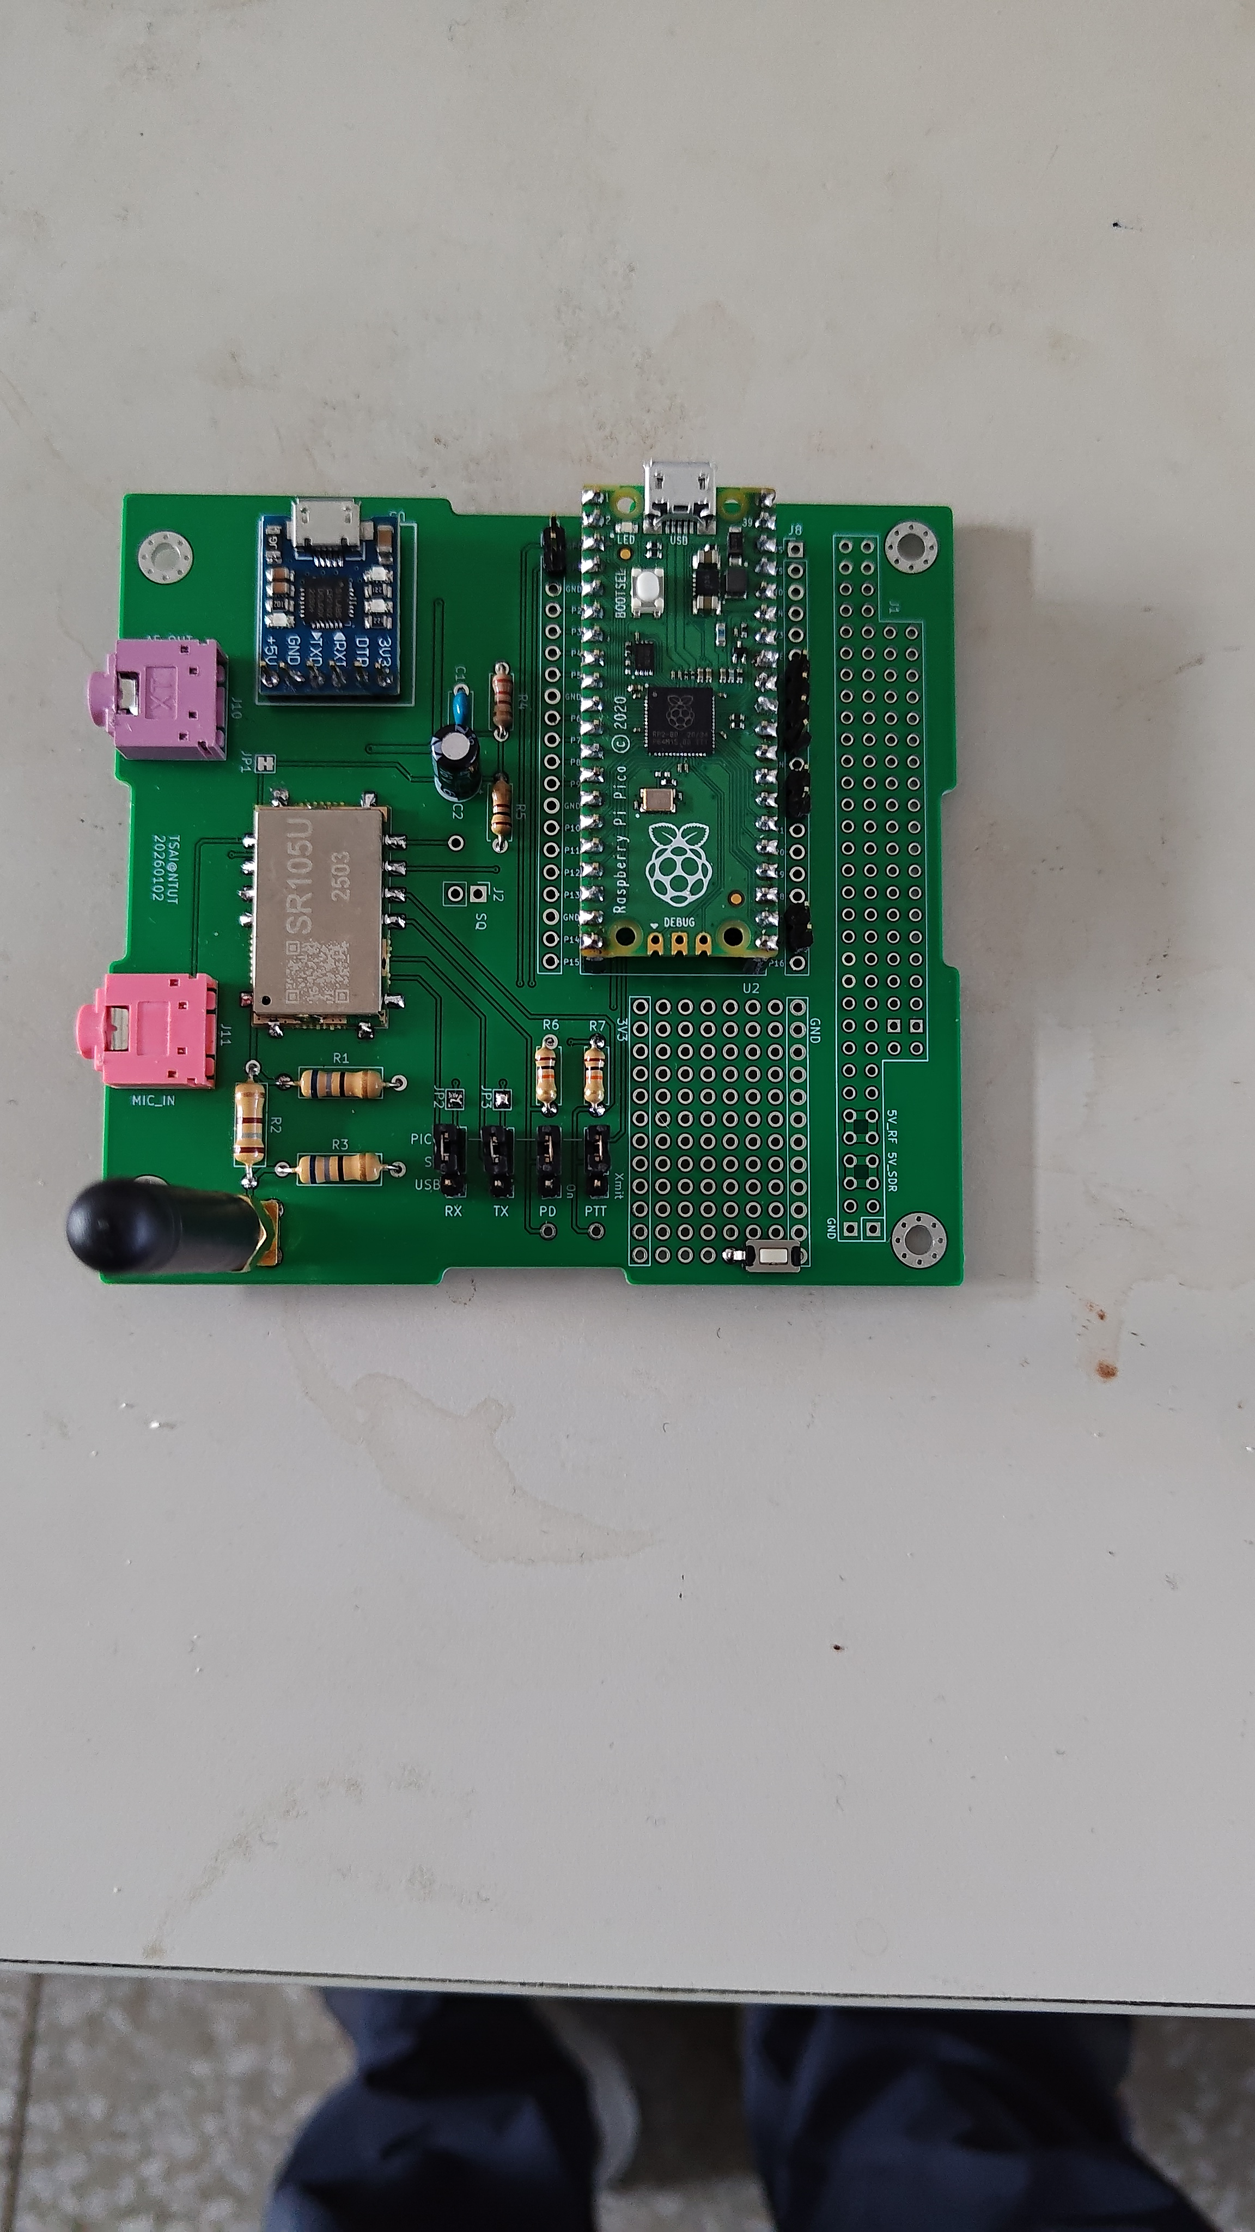

Slide 3
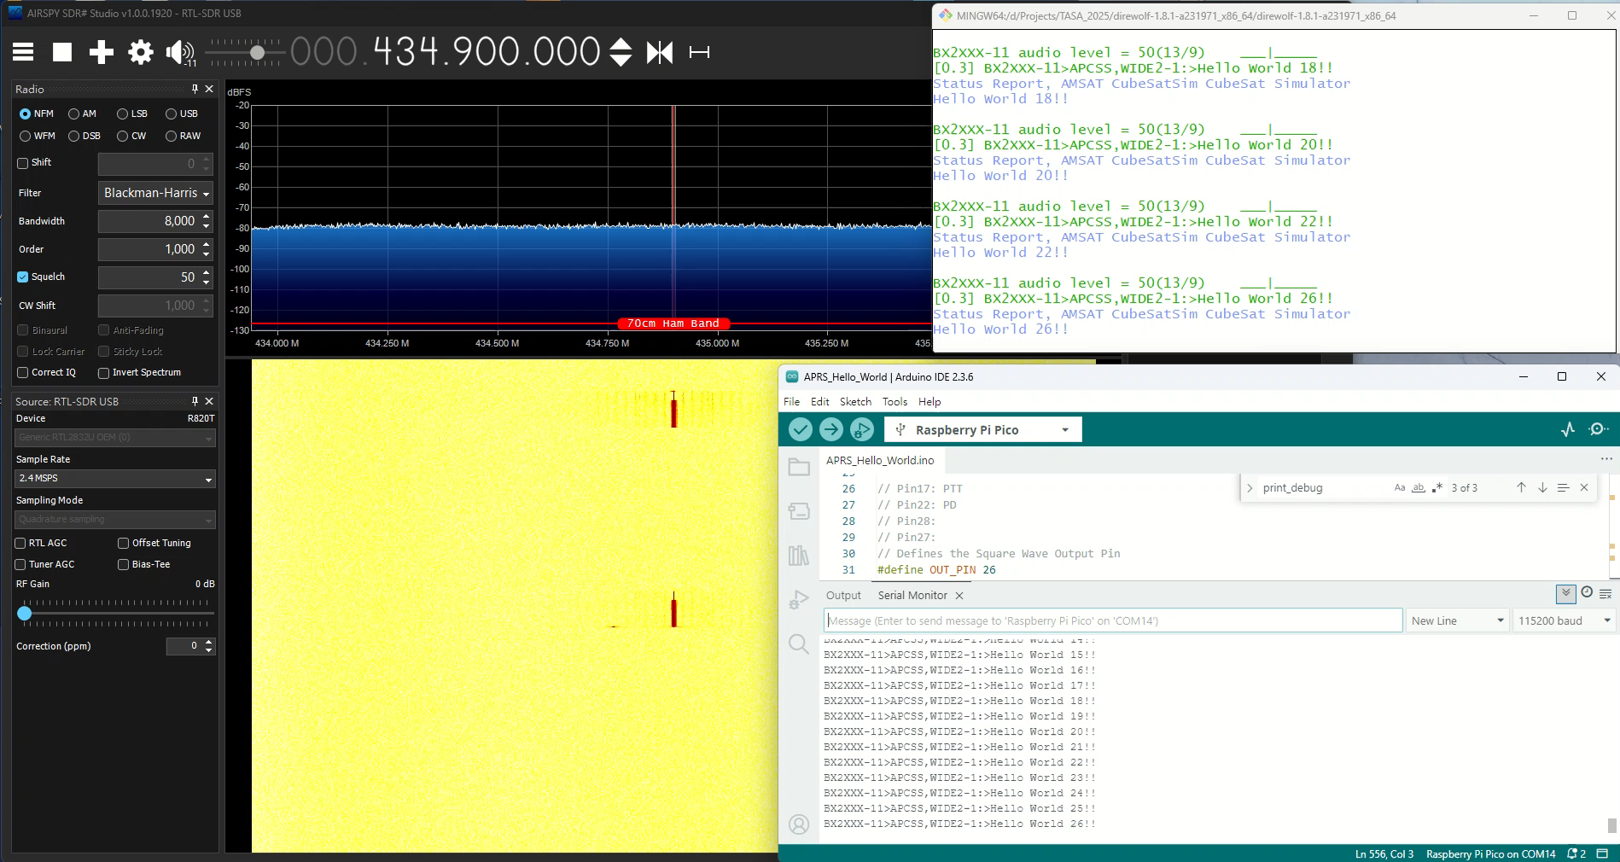

Slide 4
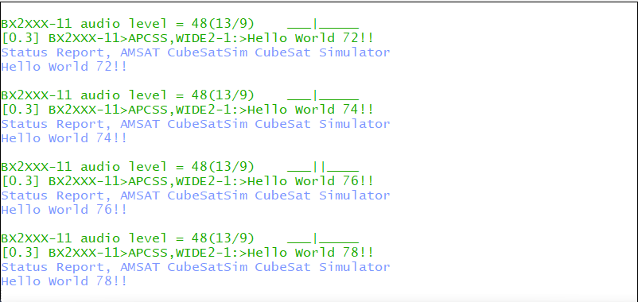
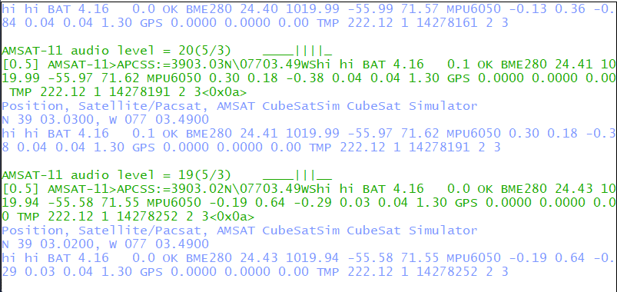
Ground
Station
RF
434.9
RTL-SDR
SDR#
VCABLE
Direwolf
CubesatSim
RF
435.9
Ground
Station
AF-OUT -> Mic
Direwolf

